Slide 1



SAP Cloud Platform – Cloud Foundry Training
Training for Ernst & Young

Slide 2


DISCLAIMER
The training content and delivery of this presentation is confidential, and cannot be recorded, or copied and distributed to any third party, without the written consent of Imarticus Learning Pvt. Ltd.

Slide 3

LEARNING OBJECTIVES
Working with HANA HDI
Explain What is HDI (HANA Deployment Infrastructure) and HDI Container
Discuss How to Start HDI Container Service in SAP® Cloud Platform(SCP) Service Market Place
Describe How to See VCAP_SERVICES Variables by Binding HDI Service to a Cloud App
Create Table in HDI, Load Data and Grant Authorization
Create new Spring App with JDBC connection to HDI
Explain the VCAP_SERVICES Environment Variable and Bind to HDI Service at Runtime
Application Security (App Router & XSUAA)
List the Security Basics
Discuss the Concept of XSUAA Service
Create Instance of XSUAA Service and secure our app
Move Code to VS Code and adapt manifest.yml
Deploy and Test Application by manually obtaining OAuth Token
Assign the role and test App
Define the Basics of Node JS
Create App Router Application
Configure xs-app.json to automate process of Auth Token

Slide 4
WHAT IS SAP HANA?
SAP HANA (high-performance analytic appliance) is an application that uses in-memory database technology that allows the processing of massive amounts of real-time data in a short time. The in-memory computing engine allows HANA to process data stored in RAM as opposed to reading it from a disk. SAP HANA is a in-memory DB. HANA Stands for High-performance Analytic Appliance.
Appliance → Specialized Hardware (SAP Certified partner) + Software
CPU
CPU
CPU
RAM
HDD, SDD
P
CPU
CPU
Hardware Innovations
Drastic reduction in the memory prices
Advancement of CPUs – massive parallelization
64 bit OS
Able to fabricate large no. of CPUs and small chips which can store massive data
Software Innovations
Partitioning
The way data is processed is also tuned
Compression
Ability to build logic around numbers rather char
Row Store v/s Columns Store

Slide 5
WHAT IS HDI?
The SAP HANA Deployment Infrastructure (HDI) provides a service that enables you to deploy database development artifacts to so-called containers. This service includes a family of consistent design-time artifacts for all key HANA platform database features which describe the target (run-time) state of SAP HANA database artifacts, for example: tables, views, or procedures. These artifacts are modeled, staged (uploaded), built, and deployed into SAP HANA.
For every container (schema) there will be 2 users which are created automatically.
SchemaOwner – Owns the object
Permission to destroy and recreate new objects, permission with grant option.
ApplicationUser – permission to Read/Write/Delete data inside the container
HDB
C
C
C
C

Slide 6
HANDS-ON: CREATE HDI CONTAINER
1
Go to cloud Dev space
2
Service Marketplace
3
Search for HANA and HDI Shared
4
Create a HDI Container service
5
Launch SAP HANA DB Explorer
6
Check the container
7
Run CF command cf env appName

Slide 7
HANDS-ON: CREATE DB TABLE
1. Launch BAS, View->Find Command->SAP HANA Database Explorer
2. Create DB Table directly in DB Explorer
3. Insert data
create column table vendor (ID int, FIRST_NAME nvarchar(80),
LAST_NAME nvarchar(80),
COMPANY_NAME nvarchar(80),
WEBSITE nvarchar(40),
EMAILID nvarchar(50),
GST_NO nvarchar(18),
PRIMARY KEY (ID)
insert into vendor (ID , FIRST_NAME,
LAST_NAME,
COMPANY_NAME ,
WEBSITE,
EMAILID,
GST_NO
) values (1, 'Melisandra', 'Austwick', 'Universidad de Colima', '51.la', 'maustwick0@51.la', '14-545-9804');
insert into vendor (ID , FIRST_NAME,
LAST_NAME,
COMPANY_NAME ,
WEBSITE,
EMAILID,
GST_NO
) values (2, 'Beryl', 'Gallimore', 'Mita', 'LebaneseUniversity', 'bgallimore1@wiley.com', '03-926-7955')
insert into vendor (ID , FIRST_NAME,
LAST_NAME,
COMPANY_NAME ,
WEBSITE,
EMAILID,
GST_NO
) values (3, 'Giff', 'Kendrick', 'Pixope', 'Irkutsk State University', 'gkendrick2@tripod.com', '87-482-7076')

Slide 8
HANDS-ON: RUN AND TEST QUERY
1. Grant permission to HDI user
grant select, insert, update, delete on vendor to <HDI user w/o quote>;

Slide 9
HANDS-ON: CREATE SPRING APP TO WORK WITH HDI
1. Create spring boot App (just web project)
2. Create vendor class
3. Add dependencies
4. Create REST API implementation (VendorController in controller package)
5. Create VendorOperation class for busienss logic (package - businesslogic)
<dependency>
<groupId>org.springframework.cloud</groupId>
<artifactId>spring-cloud-cloudfoundry-connector</artifactId>
<version>1.2.2.RELEASE</version>
<scope>runtime</scope>
</dependency>
<dependency>
<groupId>com.sap.hana.cloud</groupId>
<artifactId>spring-cloud-cloudfoundry-hana-service-connector</artifactId>
<version>1.0.4.RELEASE</version>
</dependency>
<dependency>
<groupId>org.springframework.cloud</groupId>
<artifactId>spring-cloud-spring-service-connector</artifactId>
<version>1.2.2.RELEASE</version>
</dependency>
<dependency>
<groupId>com.sap.cloud.db.jdbc</groupId>
<artifactId>ngdbc</artifactId>
<version>2.3.55</version>
</dependency>
<dependency>
<groupId>net.sourceforge.argo</groupId>
<artifactId>argo</artifactId>
<version>3.39</version>
</dependency>

Slide 10
CONTINUE…
6. Implement connection setting and simple get entity set operation (inside operation class)
7. Return Vendor object to controller
8. Implement single get
9. Implement insert
10. Bind the hdi Service in manifest json
Solution
https://github.com/soyuztechnologies/04hdicrudjdbc.git

Slide 11
HANDS-ON: CONNECT TO VCAP_SERVICE
Fetch HDI Enviornment VCAP_SERVICES
Structure of VCAP_SERVICES
VCAP_SERVICES: {
"serviceName": [
"credentials"{
--this is the object we see
}
]
}

Slide 12

Break

Slide 13
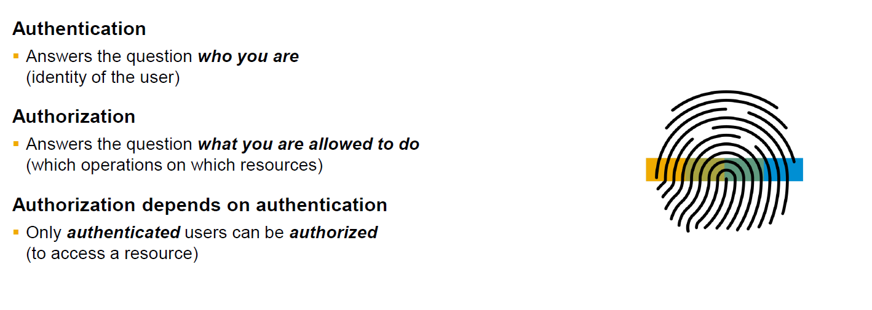
SECURITY BASICS

Slide 14
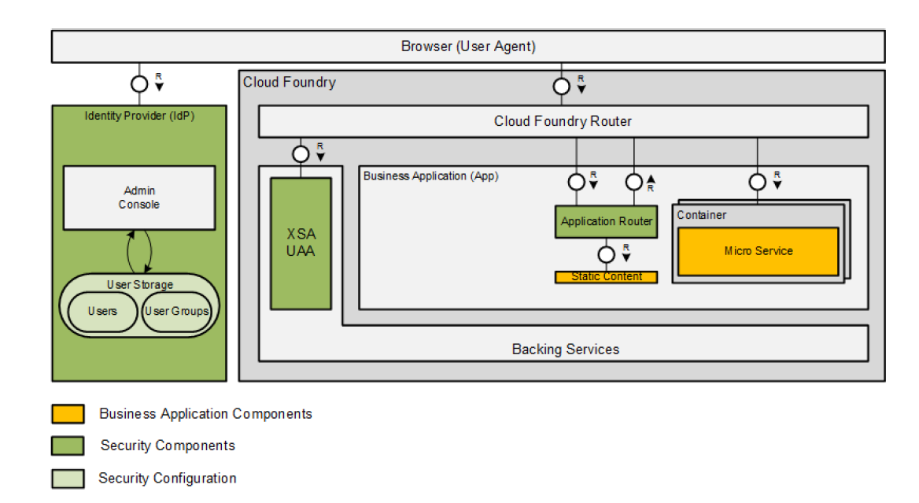
SECURITY ARCHITECTURE

Slide 15
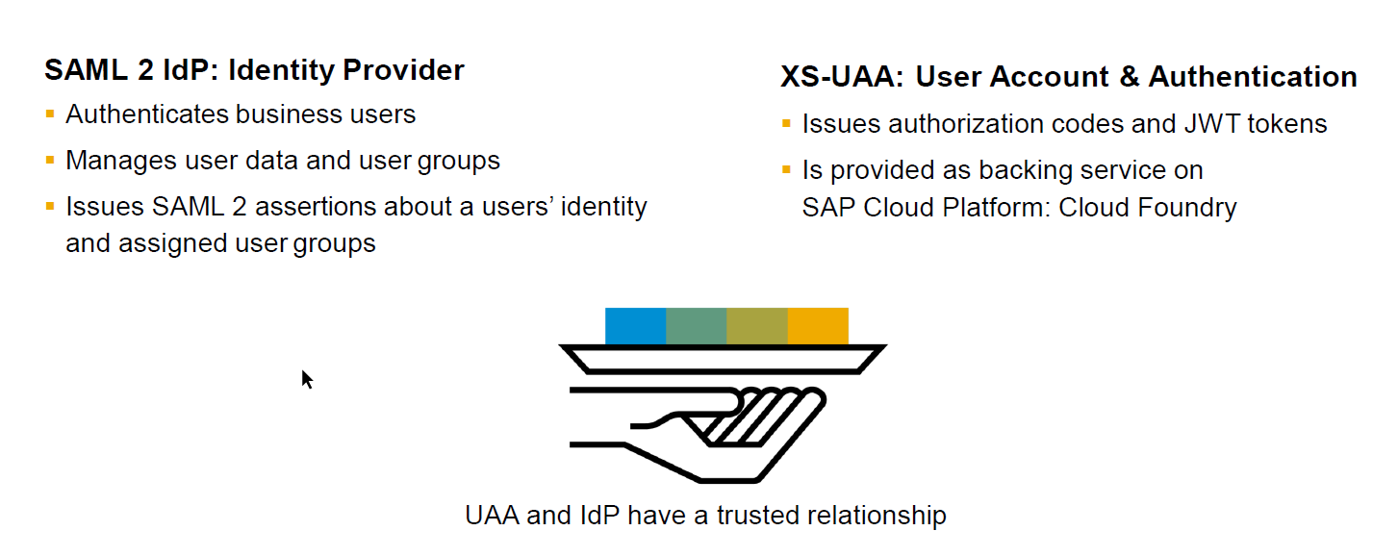
IDP AND UAA

Slide 16
HANDS-ON: CREATE AN XSUAA SERVICE INSTANCE
1. Create xs-security.json
https://help.sap.com/viewer/4505d0bdaf4948449b7f7379d24d0f0d/2.0.03/en-US/3bfb120045694e21bfadb1344a693d1f.html
2. Create a new service instance of xsuaa service in cf
Name: xsuaamicro
serviceplan: application
CHECK:
cf services
3. Go to trial a/c level in security section and create now a role collection
RoleMicroservice

Slide 17
HANDS-ON: ADD SECURITY CODE TO JAVA APP
1. Create a folder microservice add the project copy in that
2. copy project folder
3. rename project name in pom.xml
4. import maven project in eclipse
5. move manifest outside to main microservice dir
6. Java Project eclipse
6.1 add pom dependency from https://github.com/SAP/cloud-security-xsuaa-integration/tree/master/spring-xsuaa
6.2 Create new package security and Security module class and bring code from
https://github.com/SAP/cloud-security-xsuaa-integration/tree/master/spring-xsuaa
Spring documentation
https://www.baeldung.com/spring-security-oauth-jwt
[Issue] In the POM.xml add also dependency of auto configuration

Slide 18
CONTINUE…
6.3 After build Change manifest to add a route
routes:
- route: https://anubhavapp.cfapps.eu10.hana.ondemand.com
the route must be unique
Commands: cf apps, cf services, cf delete <appname> -f, cf push, cf logs appname --recent
6.4 check enviornment cf env <appname>
Solution
https://github.com/soyuztechnologies/05HDICRUDSecure.git

Slide 19
HANDS-ON: TEST THE APP IN POSTMAN
1. Make a Get call to get Token from XSUAA Service
"clientid": "sb-Microservice!t53603", //client_id to pass postman
"clientsecret": "a0O7pcuDVo4w+HqYE8kip9R+mkQ=", //client_secret
"url": "https://300333ddtrial.authentication.eu10.hana.ondemand.com", //add /oauth/token
username, password -- emailid and password of cf
grant_type password
response_type token
2. Call GET method to access /Vendors
authorization Bearer token
Content-Type application/json
--SAVED POSTMAN Calls

Slide 20

WHAT IS NODE JS?
Node.js is an open-source, cross-platform JavaScript runtime environment used for executing JavaScript code outside of a web browser.
Node.js is a great web framework for beginners because it works great for data-intensive applications, like streaming and real-time apps, and Node.js makes it easy to start building the back-end.

Slide 21
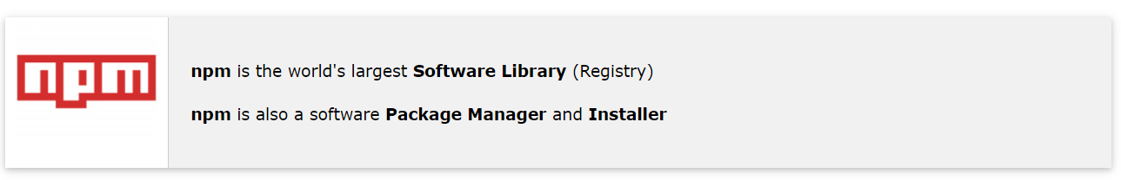
WORKING WITH NPM
The World's Largest Software Registry (Library)
npm is the world's largest Software Registry.
The registry contains over 800,000 code packages.
Open-source developers use npm to share software.
Many organizations also use npm to manage private development.

Slide 22
HANDS-ON: NODE JS BASICS
Create first node js project
Understand npm init command
Create a node module
Reuse node module
Reuse a node module from internet express
Code
https://github.com/soyuztechnologies/06Microservice/blob/master/nodeApp/nodebasics.js

Slide 23
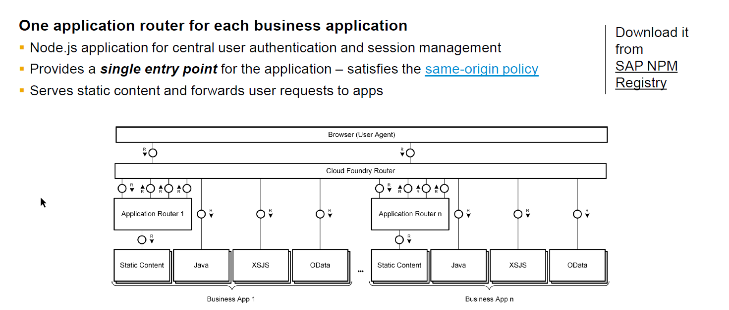
WHAT IS APP ROUTER?

Slide 24
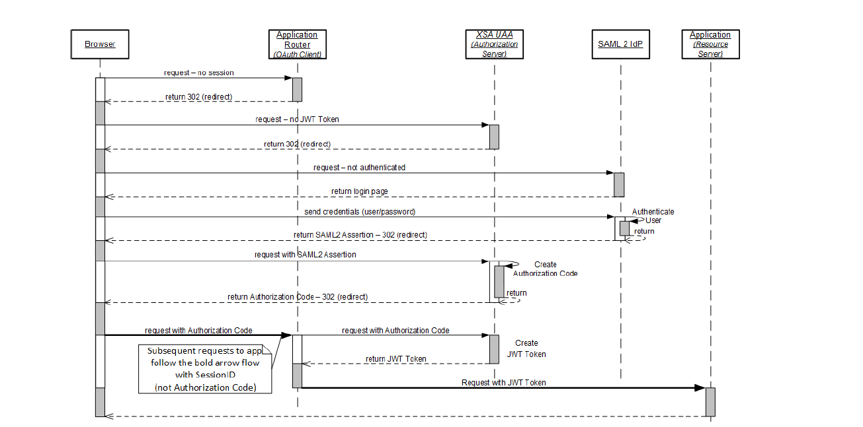
SEQUENCE OF CALLS

Slide 25
HANDS-ON IMPLEMENTING APP ROUTER
Set SAP NPM Registry
npm config set @sap:registry https://npm.sap.com
https://help.sap.com/viewer/4505d0bdaf4948449b7f7379d24d0f0d/2.0.03/en-US/726e5d41462c4eb29eaa6cc83ff41e84.html
2. Move Java project to new VS Code project and create central manifest File
3. Create App Router Directory
4. Initialize Node project
5. Set Start Script as node node_modules/@sap/approuter/approuter.js
6. Add xs-app.json
{
"routes": [
{
"source": "^/java",
"target": "/",
"destination": "springapp"
} ]
}

Slide 26
CONTINUE…
7. Define App Router config in manifest.yml
- name: approuter
buildpack: nodejs_buildpack
memory: 128M
routes:
- route: https://approuter-anubhavapp.cfapps.eu10.hana.ondemand.com
timeout: 100
path: approuter
services:
- xsuaams
env:
destinations: >
[
{
"name": "springapp",
"url": "https://hdicrudjdbc-anubhavapp.cfapps.eu10.hana.ondemand.com",
"forwardAuthToken": true
},
{
"name": "nodeapp",
"url": "https://nodeApp-anubhavapp.cfapps.eu10.hana.ondemand.com",
"forwardAuthToken": true
}
]
7. Deploy and test the app
App Code
https://github.com/soyuztechnologies/06Microservice.git

Slide 27

Summarize
LET’S SUMMARISE!

Slide 28

Summarize
End of Day 1

Slide 30



We’re committed to empower you to be
#FutureReady
through powerful training solutions.
We build the workforce of the future.
250+
Corporate Clients
30,000+
Learners Trained
25000+
Learners Placed
FREE WEBINARS
Sign up for free webinars with industry experts every fortnight!
Enroll Now!
Contact us today!
https://imarticus.org/

